Slide 1



Capstone Project 2 On Yes Bank Stock Closing Price Prediction
BY- ANKIT RAI

Slide 2

Introduction
YES bank is an abbreviation for Youth Enterprise Scheme Bank. Because the stock market is one of the most popular sectors, stock market price prediction is a popular issue for academics in both financial and technical fields. Our project's goal is to create a prediction model for close price prediction. A stock market is a public market in which shares of publicly traded corporations can be bought and sold.Stock price prediction using machine learning provides an estimate of the future worth of a company's stock and other financial assets traded on an exchange.The main point of predicting stock prices is to make large gains is the psychological aspect, namely crowd behaviour, is one of the factors involved in the prediction. All of these factors combine to make accurate prediction of share prices extremely difficult.

Slide 3
Objective
Yes Bank is a well-known banking institution in India. It has been in the headlines since 2018 due to the Rana Kapoor fraud case.Because of this, it was intriguing to analyse how it affected the company's stock values and whether any forecasting models can do justice to such situations. This dataset contains the bank's monthly stock prices since its inception, including the closing, starting, highest, and lowest stock values for each month.The main goal is to forecast the stock's monthly closing price.This dataset contains YES BANK's monthly stock prices since its creation, including the closing, starting, highest, and lowest stock values for each month.The main goal is to forecast the stock's monthly closing price.

Slide 4
Data Description
Data Description: It is critical to comprehend the data before conducting any operations on it. We examined the dataset after loading it by inspecting a few of the initial and end rows. We examined the dataset's form and discovered that it has 185 rows and 5 feature columns.Let's look at the features in our dataset.• Date: It denotes the date of the investment (in our example, the month and year).
• Open: The price at which a stock began trading when the opening bell rang.
• High: The highest prices in a specific time period are referred to be high.
• Low: The lowest prices in a certain time period are referred to as low.
• Close: A person's pricing is referred to as close.

Slide 5
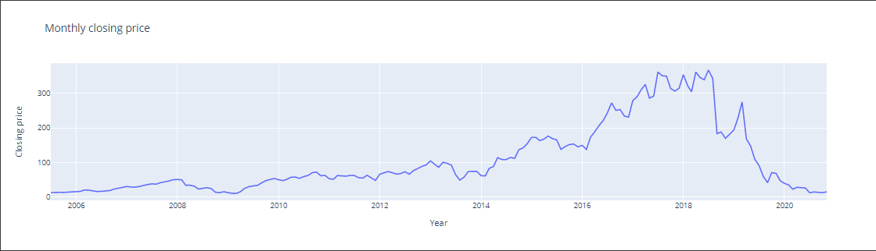
EDA : Visualizing our dependent variable
The. graph depicts how the closing price changes with each passing year.The graph plainly shows that around 2018, when the fraud case involving Rana Kapoor came to light, there was a definite dramatic drop in the stock price of Yes Bank data

Slide 6
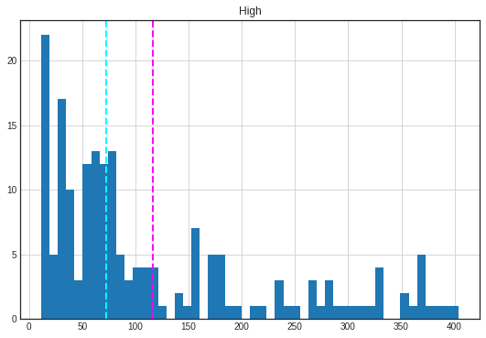
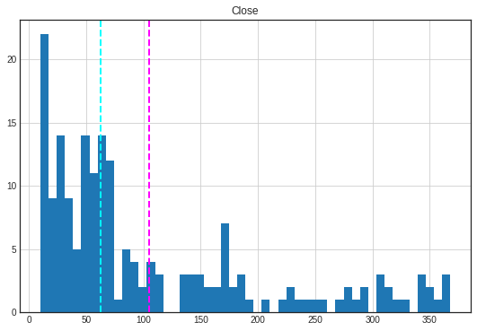
The dependent variable is plotted. We can observe that our dependent variable proximity is biassed positively (as seen on the left).So we apply a log transform to it and plot the result, as seen in the right chart. This approximates the normal distribution and is ideal for the performance of our model. Our mean and median are now almost equal.

Slide 7
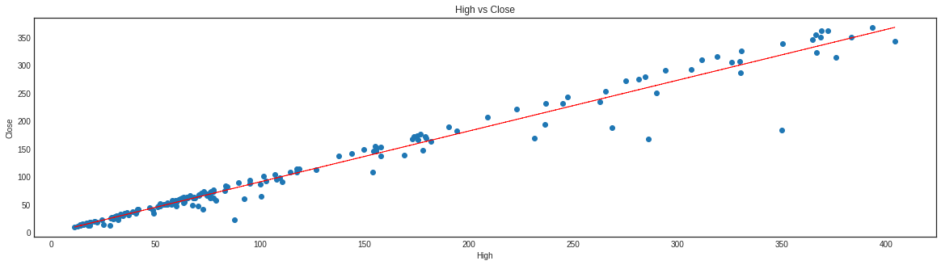
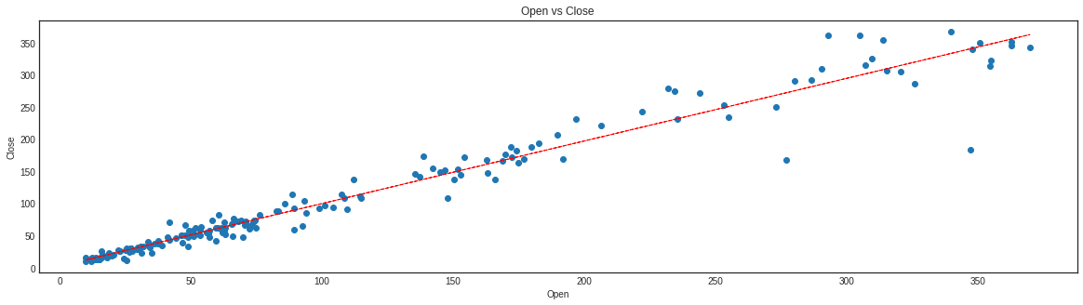
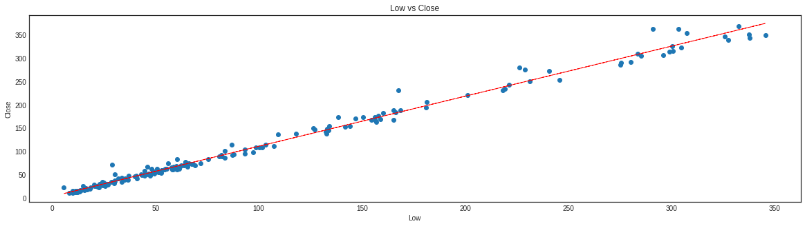
Scatter plot for the relationship between dependent & independent variables
As we can see, there is a linear relationship and a high correlation between each independent variable and our dependent variable. Additionally, the value of correlation between dependent variable Close and feature High is 0.985.

Slide 8
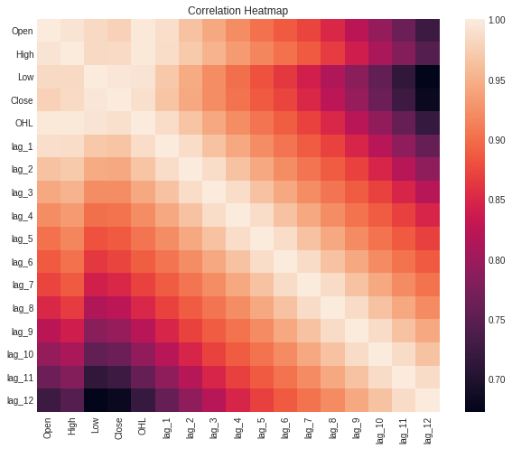
Correlation Heatmap
The correlation matrix allows us to see the relationship between each parameter and each other parameter.For the highest to lowest correlation values, the colours go from blue to red, and vice versa.The heatmap on this slide shows that our dependent variable (close price) is substantially associated with all of the other independent factors.
To reduce multicollinearity, we can employ regularisation, which involves keeping all of the characteristics but reducing the size of the model's coefficients. When each predictor contributes to predicting the dependent variable, this is a good solution.

Slide 9
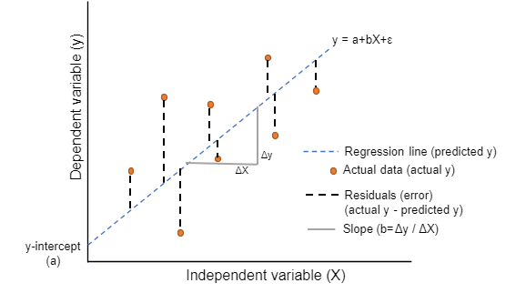
Model Implementation
We implemented the following models on our data based on the linear relationship between the dependent and independent variables in our data
Lasso Regression with Cross-validation
Linear Regression
Cross-validation
Ridge Regression
Cross-validation Elastic Net Regression
We fit these models to training data, learn model parameters, and then predict on test data. The performance of these models is then evaluated using several metrics such as: - Denote Absolute mistake.
RMSE and mean squared error
R-squared Adjusted Finally, based on these measures, we choose the best performing model.

Slide 10
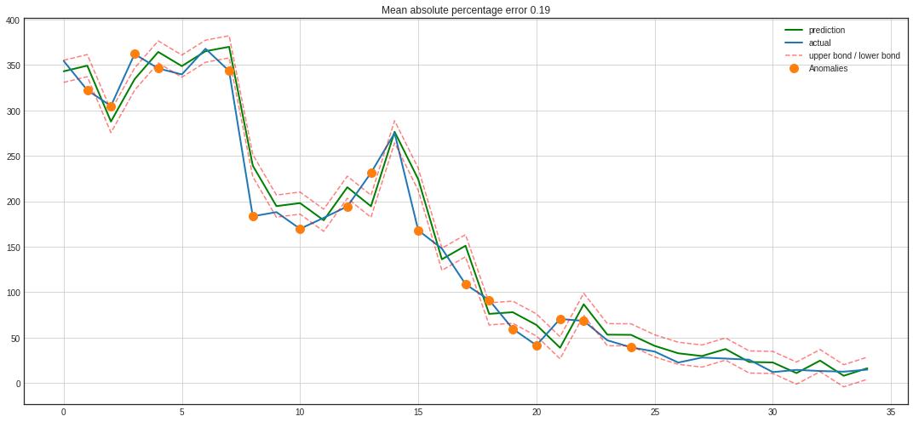
Implementing ridge regression
mean absolute error: 16.93
mean squared error: 486.35
root mean squared error: 22.05
r2_score: 0.97 mean absolute percentage error: 0.19

Slide 11
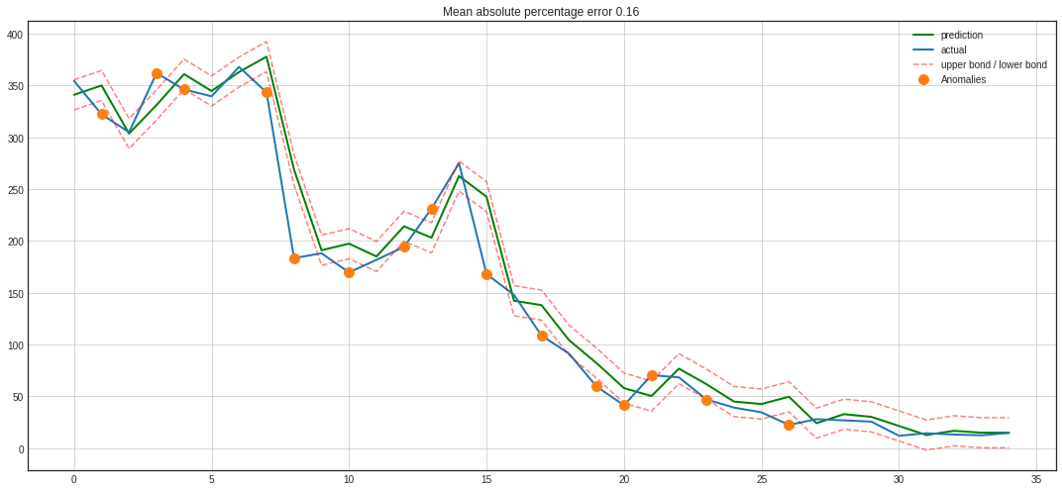
Implementing lasso regression
mean absolute error: 16.87 mean squared error: 626.48 root mean squared error: 25.03 r2_score: 0.96 mean absolute percentage error: 0.16

Slide 12
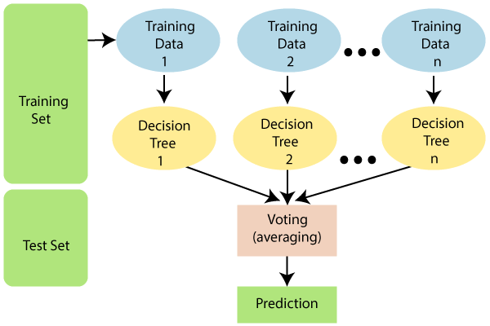
Implementing Random Forest Regressor

Slide 13
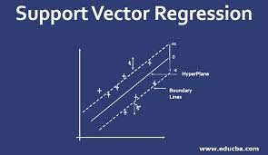
Implementing Support Vector Regressor

Slide 14
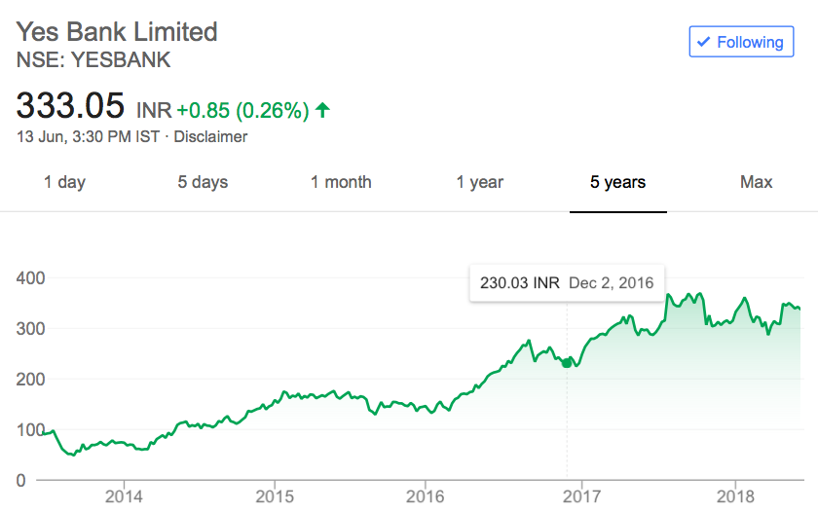
Time Series Analysis
A moving average much better than a naive forecast (y^t=yt−1). A moving average is the average of previous k values.
y^t=1k∑n=1kyt−n
Unfortunately we can make only one prediction, to make further predictions we need to have the actual observed values. However moving average can be used to identify the trends by smoothing the time series using a pandas implementation

Slide 15
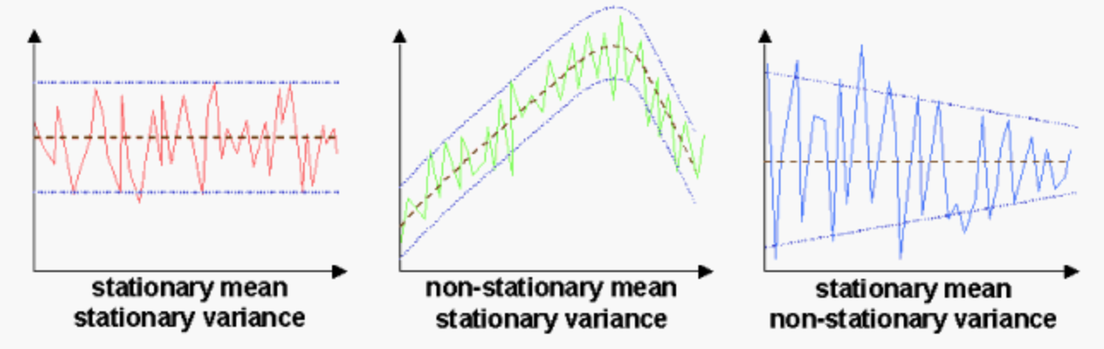
Stationarity
To make predictions, any time series must be stationary. If a process's statistical features, such as mean and variance, do not change over time, it is said to be stationary. Visual inspections or the Dickey-Fuller test are two methods for determining stationarity. The null hypothesis is that the time series cannot be represented by a unit root and is thus not stationary (has some time-dependent structure). The time series is steady, according to the alternative hypothesis (which rejects the null hypothesis).

Slide 16
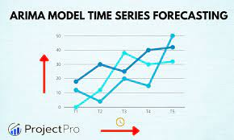
ARIMA Implementation
ARIMA - Parameters
p: Trend autoregression order
d: Trend difference order.
q: Trend moving average order.
p - is most probably 2 since it is the last significant lag on the PACF, after which, most others are not significant.
d - equals 1 because we had first differences
q - should be somewhere around 7 as well as seen on the ACF

Slide 17
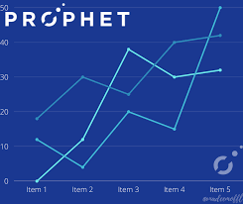
Prophet Implementation
mean absolute error: 4.57
mean squared error: 30.32
root mean squared error: 5.51
r2_score: -0.38
mean absolute percentage error: 0.16

Slide 18
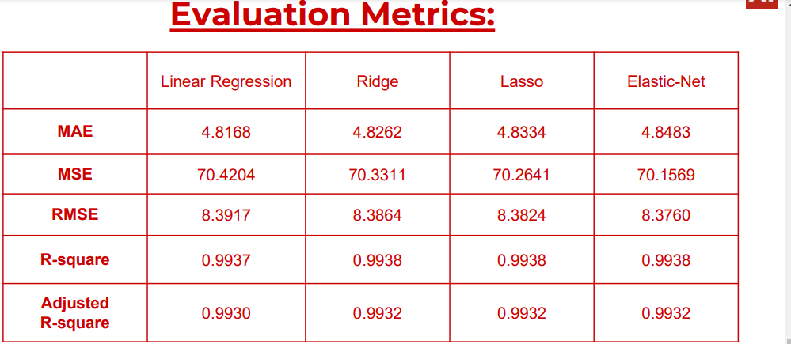
Prophet Implementation
The table above clearly shows that the best performing model is elastic net, which has higher accuracy and the lowest error value.

Slide 19
CONCLUSION
• We began with data inspection, then examined the data distribution, looked for correlation, and used averaged characteristics to remove it.
• Accuracy, mean squared error, root mean squared error, r2 score, and mean absolute percentage error were used to evaluate a basic linear regression model.
• Additional features were created by employing delays and regularisation techniques such as ridge, lasso, and elastic net regression to lessen the effect of multicollinearity.
• Regression models such as the random forest regressor, the xgboost regressor, and the support vector regressor were created.
• To do time-series analysis, the time component was introduced and averaging techniques such as moving average, exponentially weighted moving average, and double exponentially weighted moving average were utilised.
• The presence of nonstationarity was recognised, and it was made stationary by taking lags and differences into account.

Slide 20




